Slide 1
Title: Sales Performance Analysis of Walmart Stores Using Advanced MySQL Techniques
Subtitle: Final Project Submission
Name: SHIVNAYAN HASRAM KOKANI
Course/Batch: SQL/1ST MARCH

Slide 2
Introduction
Objective: Analyze transaction data to identify sales trends, customer behavior, and operational efficiencies.
Tools Used: MySQL, Excel (for growth rate or charts), PowerPoint
Dataset: Walmart Sales Transaction Dataset

Slide 3
Business Problem
Walmart’s goals:
Optimize sales strategy
Understand customer segmentation
Improve product and operational planning

Slide 4
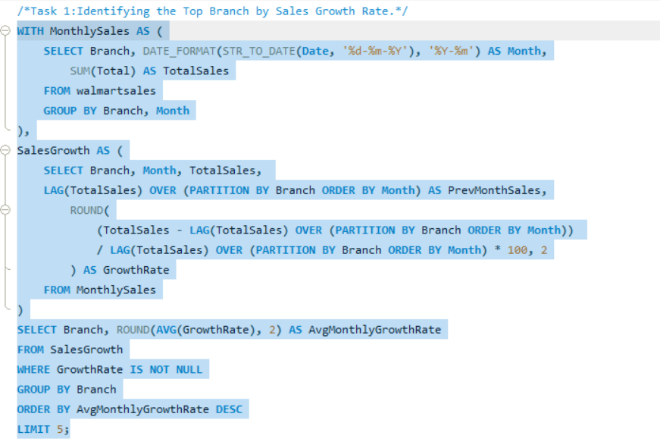
Task 1 – Top Branch by Sales Growth Rate
SQL Query:

Slide 5
Result & Chart :

Slide 6
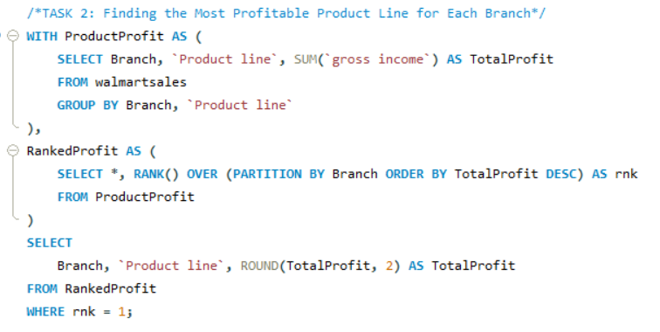
Task 2 – Most Profitable Product Line per Branch
SQL Query:

Slide 7
Result and chart :

Slide 8
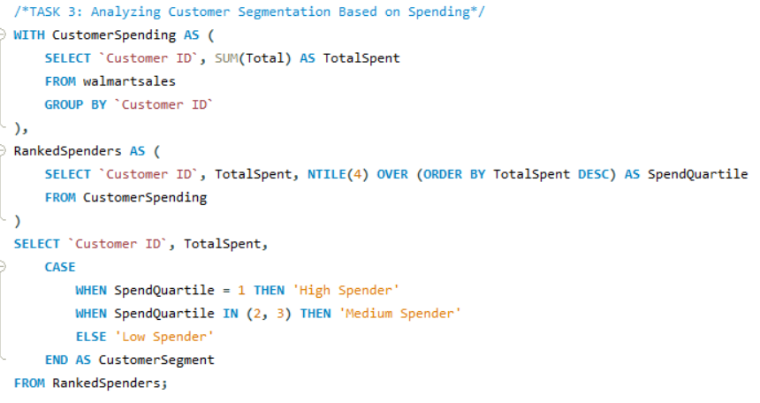
Task 3 – Customer Segmentation Based on Spending
SQL Query:

Slide 9
Result & Chart :

Slide 10
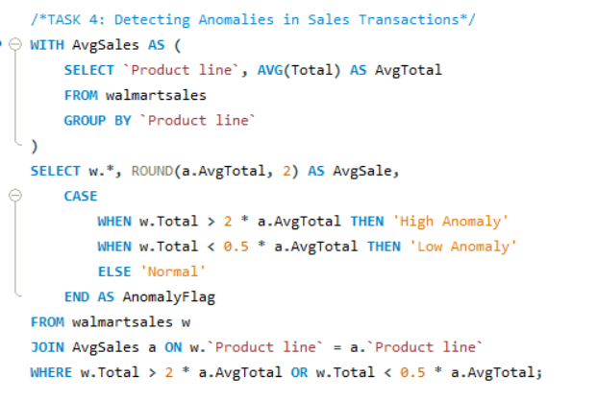
Task 4 – Detecting Anomalies
SQL Query:

Slide 11
Result :

Slide 12
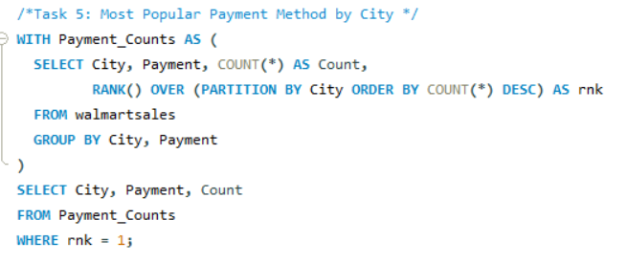
Task 5 – Most Popular Payment Method by City
SQL Query:

Slide 13
Result & Chart :

Slide 14
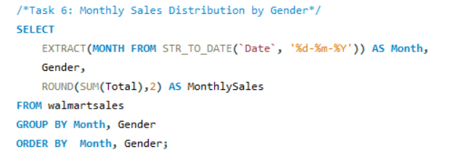
Task 6 – Monthly Sales Distribution by Gender
SQL Query:

Slide 15
Result & Chart:

Slide 16
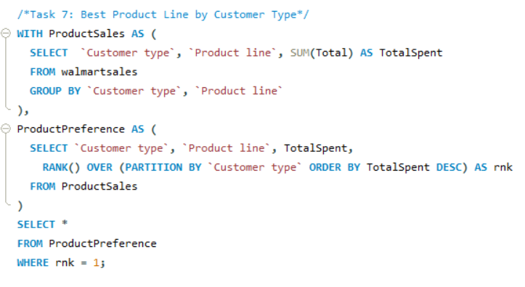
Task 7 – Best Product Line by Customer Type
SQL Query:

Slide 17
Result & Chart:

Slide 18
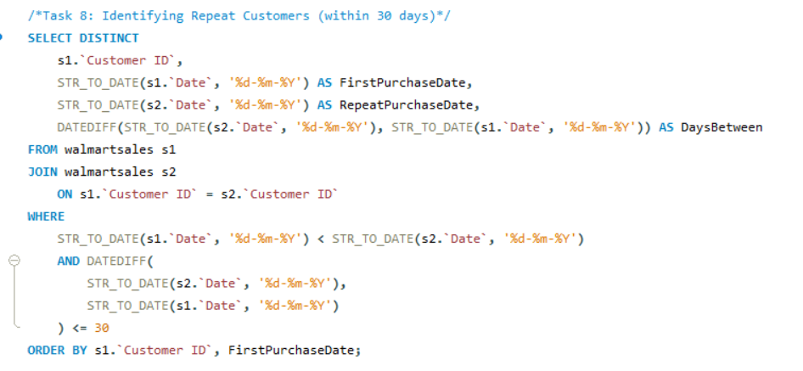
Task 8 – Identifying Repeat Customers
SQL Query :

Slide 19
Result

Slide 20
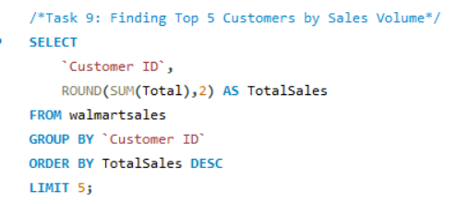
Task 9 – Top 5 Customers by Sales Volume
SQL Query:

Slide 21
Result & Chart :

Slide 22
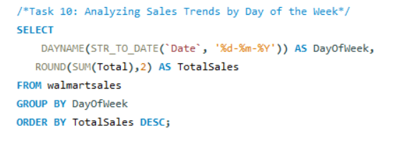
Task 10 – Sales Trends by Day of the Week
SQL Query :

Slide 23
Result & Chart :

Slide 24
Business Recommendations
Encourage promotions on Fridays to maximize revenue.
Upsell to “Medium spenders” using loyalty campaigns.
Prioritize Food & Beverages for profit optimization.

Slide 25
Project Video
Link :
https://drive.google.com/file/d/12h6WjTgLQN2tbywZRdX2PBJqlJxSMIvy/view?usp=drive_link

